Slide 1
Spring Boot 3 Observability with Grafana Stack

Slide 2
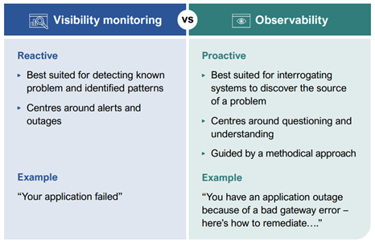
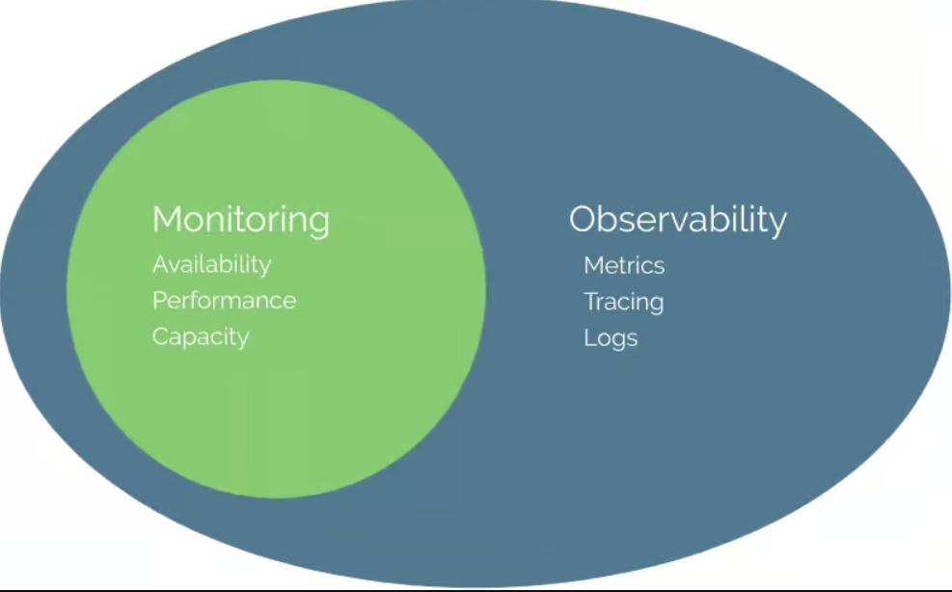
What is Observability?
In a nutshell, Observability is the process of understanding the internal state of the application with the help of different indicators such as Logs, Metrics, and Tracing information.

Slide 3
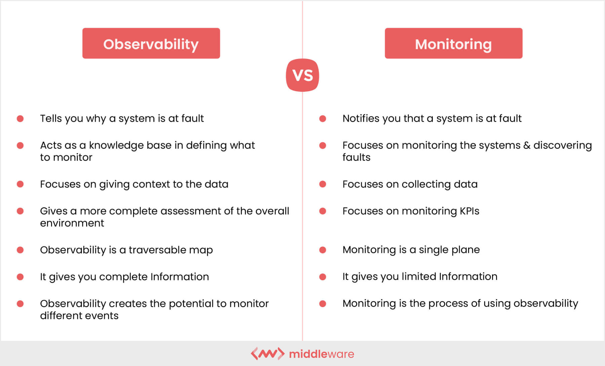

Slide 4
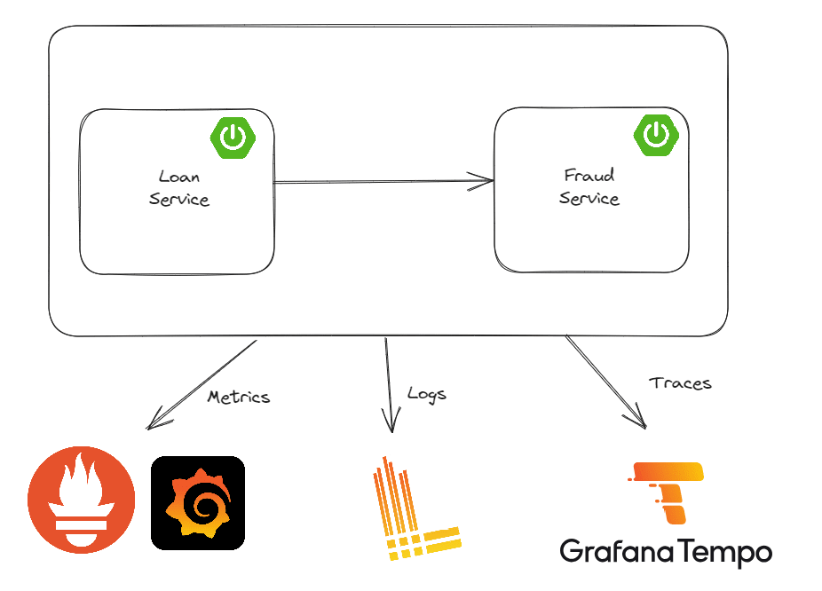
Implementing Observability : The below picture shows you a high-level overview of our project and how tools like Grafana, Loki, and Tempo fit into our overall architecture

Slide 5
Logging :
<?xml version="1.0" encoding="UTF-8"?>
<configuration>
<include resource="org/springframework/boot/logging/logback/base.xml"/>
<springProperty scope="context" name="appName" source="spring.application.name"/>
<appender name="LOKI" class="com.github.loki4j.logback.Loki4jAppender">
<http>
<url>http://localhost:3100/loki/api/v1/push</url>
</http>
<format>
<label>
<pattern>application=${appName},host=${HOSTNAME},level=%level</pattern>
</label>
<message>
<pattern>${FILE_LOG_PATTERN}</pattern>
</message>
<sortByTime>true</sortByTime>
</format>
</appender>
<root level="INFO">
<appender-ref ref="LOKI"/>
</root>
</configuration>
<dependency>
<groupId>com.github.loki4j</groupId>
<artifactId>loki-logback-appender</artifactId>
<version>1.3.2</version>
</dependency>
loki:
image: grafana/loki:main
command: [ "-config.file=/etc/loki/local-config.yaml" ]
ports:
- "3100:3100"

Slide 6
Metrics :
<dependency>
<groupId>org.springframework.boot</groupId>
<artifactId>spring-boot-starter-actuator</artifactId>
</dependency>
<dependency> <groupId>io.micrometer</groupId> <artifactId>micrometer-registry-prometheus</artifactId> <scope>runtime</scope> </dependency>
management.endpoints.web.exposure.include=health, info, metrics, prometheus
management.metrics.distribution.percentiles-histogram.http.server.requests=true
management.observations.key-values.application=loan-service

Slide 7
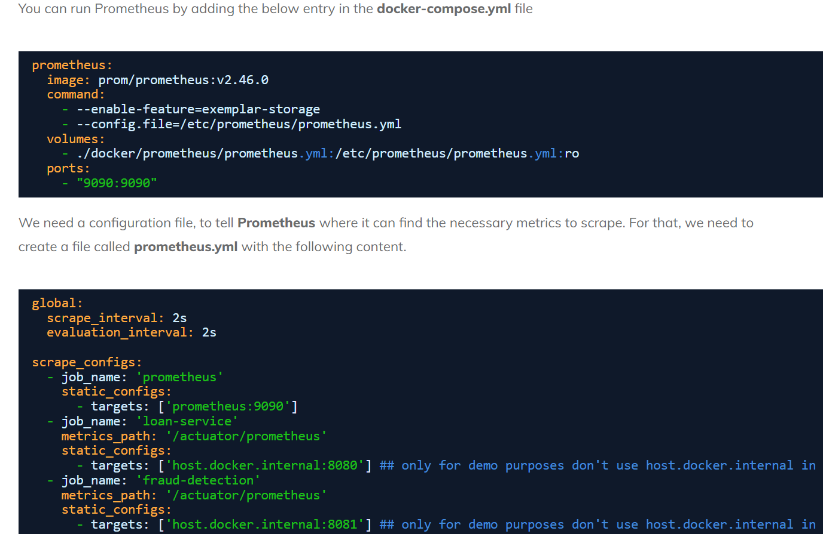

Slide 8
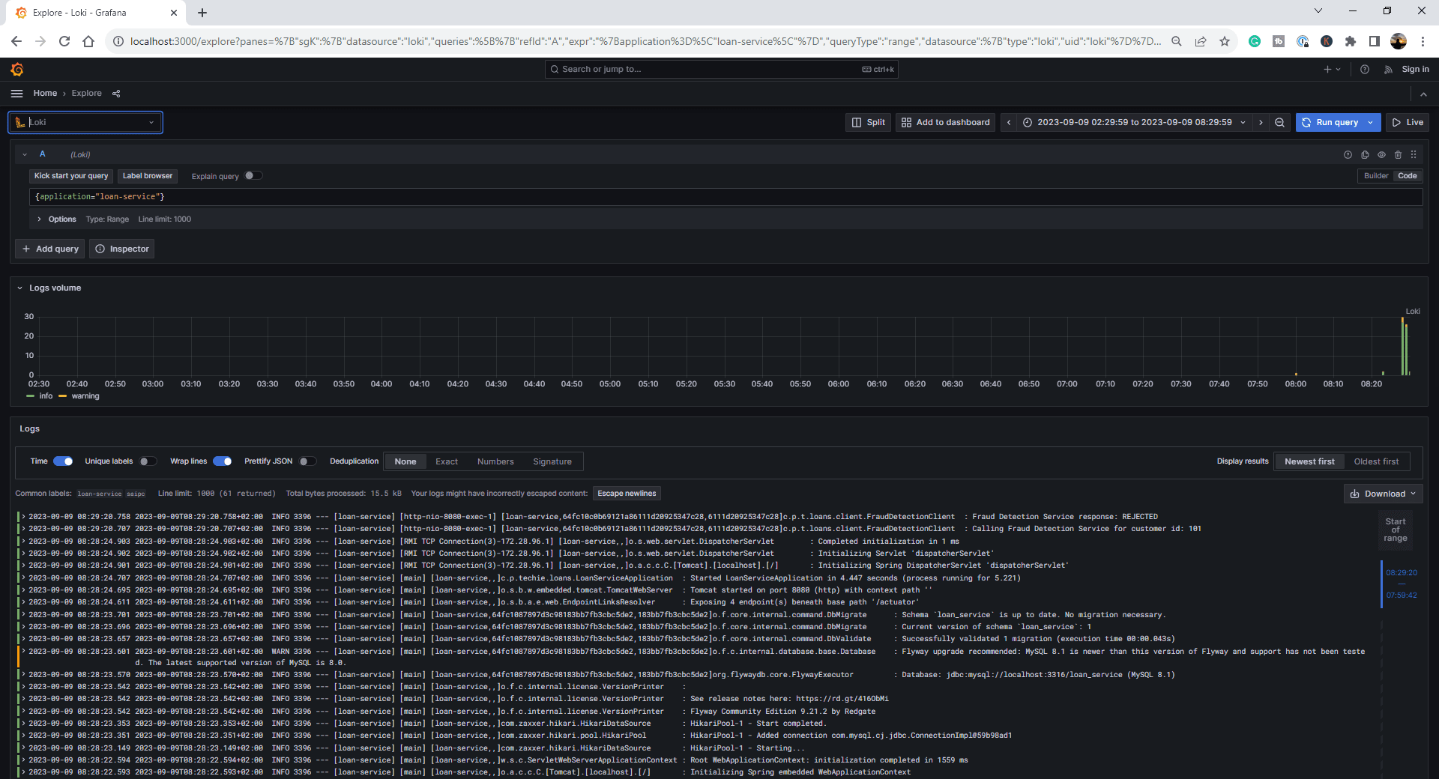

Slide 9
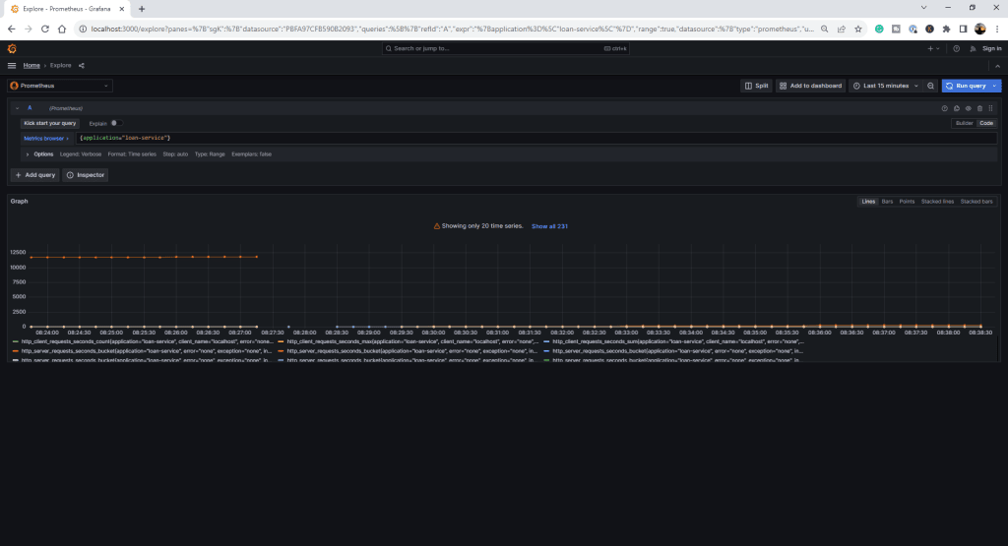

Slide 10
